Slide 1

WELCOME

Slide 2
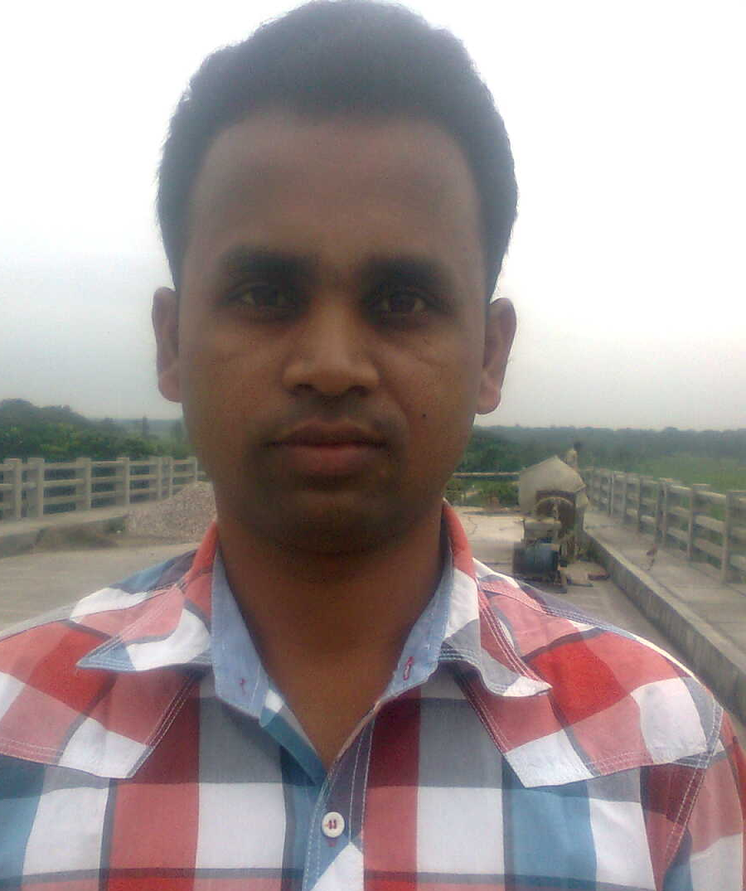
ALI HOSSIN
Assistant Teacher
CHAR KASHIM NAGAR Govt.primary school
Belabo, Narsingdi.

Slide 3


Class-One
Subject-English

Slide 4
Lesson : A house
Part of lesson :B, What`s this ? Point and say .

Slide 5
Learning outcomes
Students will be able –
1. To say the name of the pictures.
2. To match pictures with the words..

Slide 6
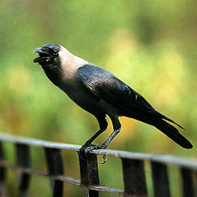

Crow
cap

Slide 7
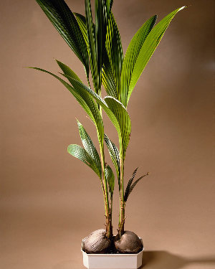

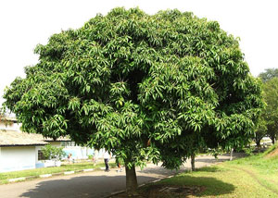
Plant
Pen
Tree

Slide 8

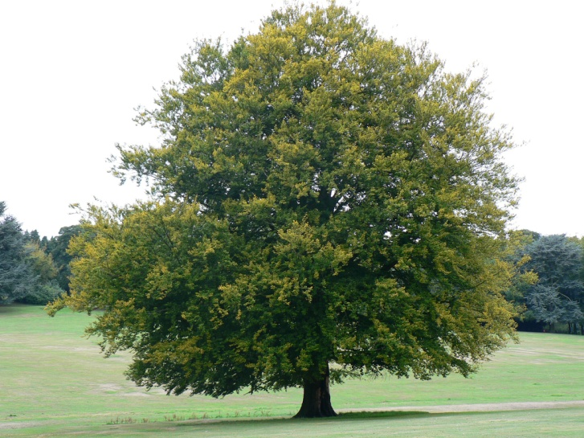
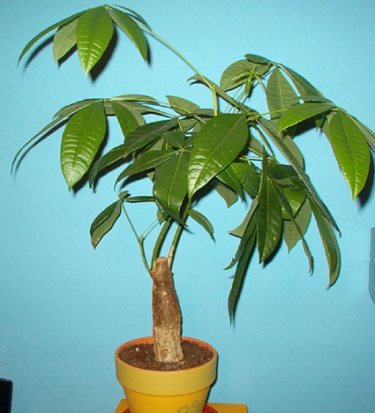
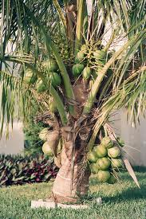

Plant
Tree
Tree
Plant
?
?

Slide 9
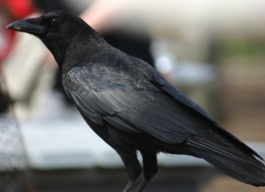
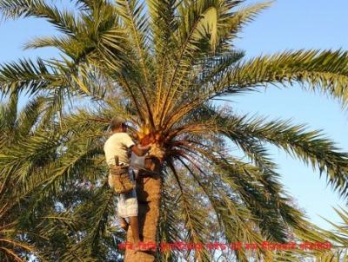



Match the words with pictures
Plant
Pen
Crow
Tree
cap

Slide 11

Thanks

